Slide 1
Elemen Differensial Panjang, Luas, Volume
Pertemuan ke-4

Slide 2
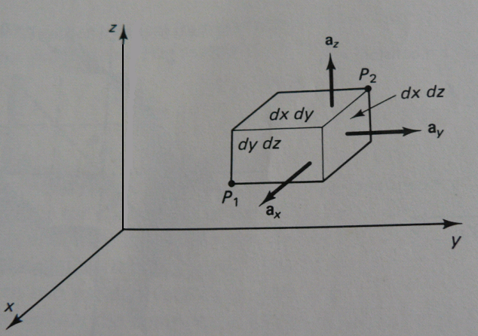
Sistem koordinat Cartesian
P₁(x, y, z)
P₂(x + Δx, y + Δy, z + Δz)
Panjang differensial dl
dl = dx a_{x} + dy a_{y} + dz a_{z}
Luas differensial
ds_{x} = dy dz a_{x}
ds_{y} = dx dz a_{y}
ds_{z} = dx dy a_{z}
Volume differensial
dv = dx dy dz

Slide 3
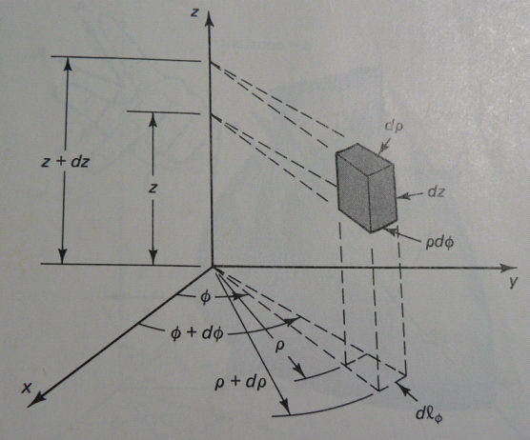
Sistem koordinat silinder
P₁(ρ, φ, z)
P₂(ρ + Δρ, φ + Δφ, z + Δz)
Panjang differensial dl
dl = dρ a_{ρ} + ρ dφ a_{φ} + dz a_{z}
Luas differensial
ds_{ρ} = ρ dφ dz a_{ρ}
ds_{φ} = dρ dz a_{φ}
ds_{z} = ρ dρ dφ a_{z}
Volume differensial
dv = ρ dρ dφ dz

Slide 4
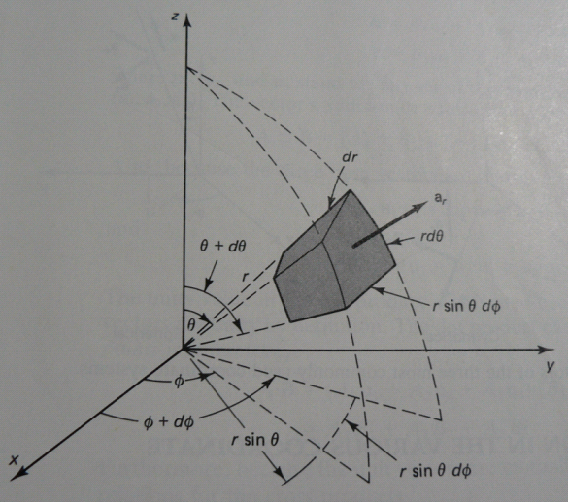
Sistem koordinat bola
P₁(r, θ, φ)
P₂(r + Δr, θ + Δθ, φ + Δφ)
Panjang differensial dl
dl = dr a_{r} + r dθ a_{θ} +
r sin θ dφ a_{φ}
Luas differensial
ds_{r} = r² sin θ dθ dφ a_{r}
ds_{θ} = r sin θ dr dφ a_{θ}
ds_{φ} = r dr dθ a_{φ}
Volume differensial
dv = r² sin θ dr dθ dφ

Slide 5
END

